Slide 1

Project Review-2
on
Prediction of Individual Income using Machine Learning
by
Sankalp Sharma (RA2011004010406) Shashwat Singh (RA2011004010374) Hussain Jamal Samuru (RA2011004010388)
Under the guidance of
Dr. S. Latha
Assistant Professor, Department of ECE

Slide 2
Abstract
This minor project report explores the application of machine learning techniques in predicting individual income. The project's primary aim is to develop accurate predictive models capable of estimating an individual's income based on a set of relevant features. In an era of rapid technological advancement, predicting individual income holds significant relevance for financial institutions, social policy planning, and personal financial management.
The project commences with a comprehensive analysis of various socio-economic factors that are likely to influence an individual's income. These factors include education level, occupation, age, marital status, and more. A diverse dataset containing anonymized individual records is used for training and evaluating the predictive models.
Multiple machine learning algorithms, including but not limited to decision trees, random forests, support vector machines, and neural networks, are implemented and fine-tuned to achieve optimal predictive performance. Feature engineering and selection techniques are employed to enhance the models' robustness and interpretability. The project assesses the models' accuracy, precision, recall, and F1-score to ensure a comprehensive evaluation.

Slide 3
Introduction
In today's rapidly evolving technological landscape, the integration of machine learning techniques has transformed numerous industries and sectors. One area that stands to benefit significantly from these advancements is economic analysis and social sciences. The prediction of individual income using machine learning holds immense potential to provide valuable insights into socio-economic trends, aid policymakers, and empower individuals in making informed financial decisions. This motivated the selection of this topic for our minor project.

Slide 4
Literature Review
PAPER TITLE | AUTHORS | INFERENCES
Adult Income Prediction Using various ML Algorithms | Sunil Thapa Lambton College - Department of Computing Date Written: January 16, 2023 | This paper compares different Machine Learning Algorithms performances using an adult income dataset. Feature engineering, feature selection, and exploratory data analysis are performed to achieve this goal. Among the five Machine Learning Algorithms used, Random Forest Classifier performed best with 86.3% training accuracy and 86% test accuracy.
Family Expenditure and Income Analysis using Machine Learning algorithms | Y. Bhavya Sri; Y. Sravani; Y. Bhargava Sai Surendra; S. Rishitha; M. Sobhana Published by IEEE in February 2022 | The prediction task is performed using Decision Tree and Random Forest Regression algorithms, as the data used for this model is continuous. Our proposed Random Forest model predicts with an accuracy of 74.35%.
Supervised machine learning predictive analytics for alumni income | Daniela A. Gomez‑Cravioto, Ramon E. Diaz‑Ramos* , Neil Hernandez‑Gress, Jose Luis Preciado and Hector G. Ceballos Published in January 2022 | Results show that the machine learning models outperformed the paramet‑ ric models of linear and logistic regression, in predicting alum’s current income with statistically signiﬁcant results (p < 0.05) in three diﬀerent tasks. Moreover, the later methods were found to be the most accurate in predicting the alum’s ﬁrst income after Graduation.

Slide 5
Objectives
Develop accurate machine learning models for predicting individual income based on relevant socio-economic features.
Explore and analyze various data preprocessing techniques to handle missing values, outliers, and feature scaling.
Identify and engineer key features that contribute significantly to the prediction of individual income.
Compare and evaluate the performance of different machine learning algorithms for accurate income prediction.
Provide actionable insights for policymakers, individuals, and financial advisors based on the developed prediction models.

Slide 6

Design Methodology / Approach:
Data Collection: Gather a comprehensive dataset containing individual socio- economic features and corresponding income levels.
Data Preprocessing: Cleanse the data by handling missing values, outliers, and data inconsistencies.
Feature Engineering: Select and engineer relevant features that could impact income prediction.
Model Selection: Experiment with various machine learning algorithms such as linear regression, decision trees, random forests, and gradient boosting.
Model Training and Validation: Split the dataset into training and testing sets for model training, tuning, and validation.
.

Slide 7
Models Used
KNN Classifier : A K-nearest neighbors (KNN) classifier is a supervised machine learning algorithm used for classification and regression problems. It works by finding the K nearest points in the training dataset and uses their class to predict the class or value of a new data point
SVM : Support vector machine (SVM) is a machine learning algorithm that uses supervised learning models to solve complex classification, regression, and outlier detection problems. SVMs are particularly good at solving binary classification problems, which require classifying the elements of a data set into two groups.

Slide 8
Models Used(contd.)
Logistic Regression : Logistic regression is a statistical method that uses mathematics to find relationships between two data factors. It then uses this relationship to predict the value of one of those factors based on the other. The prediction usually has a finite number of outcomes, like yes or no
Random Forest: A random forest is a machine learning technique that uses many decision trees to solve classification and regression problems. It's an ensemble learning method that combines the output of multiple decision trees to reach a single result.

Slide 9
Models Used(contd.)
XGBoost:
XGBoost is a scalable and highly accurate implementation of gradient boosting that pushes the limits of computing power for boosted tree algorithms, being built largely for energizing machine learning model performance and computational speed.
Naïve Bayes: Naive Bayes is a statistical classification technique based on Bayes' Theorem. It's a supervised learning algorithm that's fast, accurate, and reliable, especially on large datasets

Slide 10
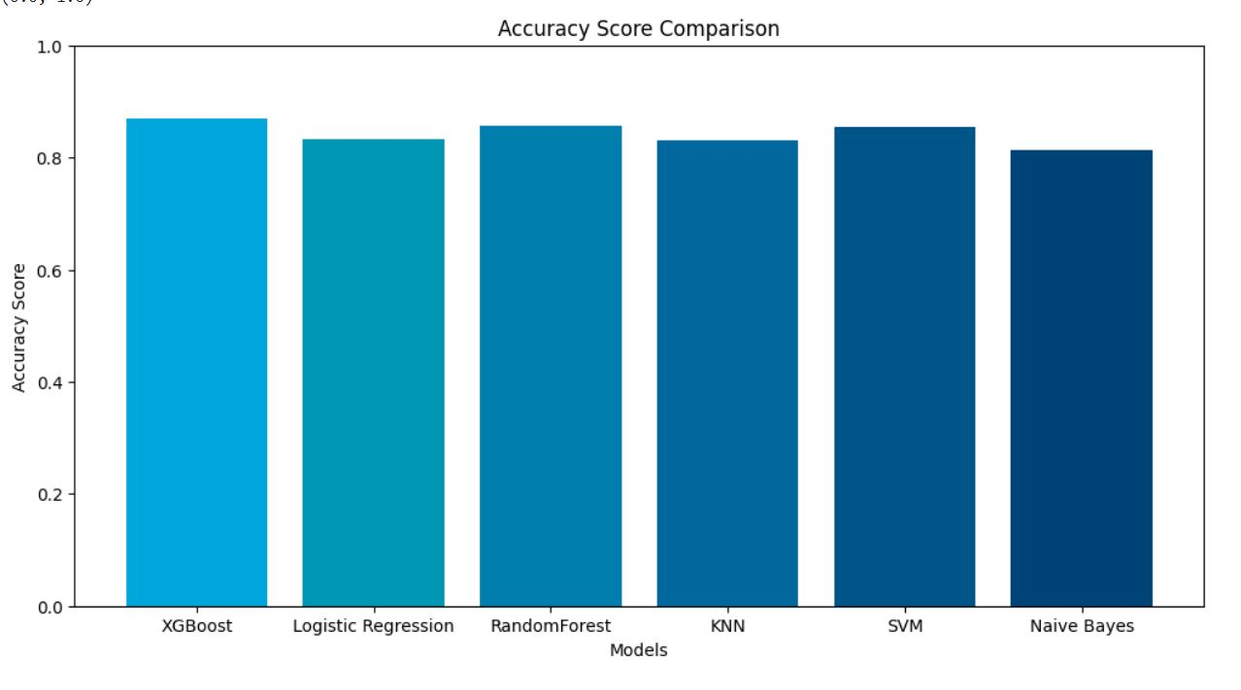
Results
After testing the dataset on 6 different ML models including SVM,XGBoost,Logistic Regression,Random Forest, KNN , Naïve Bayes, We found out that the maximum accuracy was found out on XGBoost model.
The respective accuracies of all the models used are given as :

Slide 11
Conclusions
We conclude that after using all the different machine learning algorithms used ,
The accuracy was the highest by using XGBoost Model with an accuracy of 87.01 % after hyper – parameter tuning .
Following Xgboost ,
Random Forest got us an accuracy of 85.101 %
KNN got us an accuracy of 83.16 %
SVM an accuracy of 84.747 %
Logistic Regression an accuracy of 83.30%

Slide 12
References
https://digitalcommons.bryant.edu/cgi/viewcontent.cgi?artic le=1038&context=honors_economics
https://medium.com/analytics-vidhya/machine-learning- application-census-income-prediction-868227debf12
https://ieeexplore.ieee.org/document/9990316

